Slide 1
PHD presentation
Kunal Ray
Batch 39
INSOFE

Slide 2
Data provided
Train.csv: Flight Trip Details
Attribute Name | Data Type | Description
FlightNumber | ID | ID
Year | Date | Travel Year
Month | Date | Travel Month
DayofMonth | Date | Travel Date – day of Travel Month
DayofWeek | Categorical | Day of week (1 to 7)
ScheduledDepTime | Time Stamp | Scheduled flight departure time at Origin
ScheduledArrTime | Time Stamp | Scheduled flight arrival time at Destination
ScheduledTravelTime | Integer | Scheduled travel time in minutes
Origin | ID | Flight starting location code
Destination | ID | Flight destination location code
Distance | Integer | Distance in miles b/w origin & destination
ActualArrivalTimeStamp | Date Time | Flight Actual Arrival TimeStamp

Slide 3
Data provided
Weather Data (*hourly.txt)
Attribute Name | Data Type | Description
WeatherStationID | ID | ID
YearMonthDay | Date | Date
Time | Time | Reported as Local Standard Time
SkyConditions | Categorical | SkyConditions
Visibility | Numeric | Visibility measured in Statuet Miles (SM)
DBT | Numeric | Dry Bulb Temperature – reported in deg C
DewPointTemp | Numeric | In deg C
RelativeHumidityPercent | Numeric | In %age
WindSpeed | Numeric | Reported in knots
WindDirection | Numeric | Direction from which wind blows. Reported to nearest degree, from true north
WindGustValue | Numeric | Maximum 5-second peak wind speed measured
StationPressure | Numeric | The pressure felt at that station or spot, but not adjusted to an equivalent at sea level

Slide 4
Data provided
Precipitation Data (*hpd.txt)
Attribute Name | Data Type | Description
WeatherStationID | ID | ID
YearMonthDay | Date
Time | Time Stamp | Reported as Local Standard Time
HourlyPrecip | Numeric | Precipitation to measure rain fall amount (in mm)
AllStationsData_PHD.txt
Attribute Name | Data Type | Description
WeatherStationID | ID | ID
AirportID | ID | ID
GroundHeight | Numeric | GroundHeight
StationHeight | Numeric | StationHeight
BarometerHeight | Numeric | BarometerHeight
Latitude | Numeric | Measure for precise location
Longitude | Numeric | Measure for precise location
TimeZone | Categorical | TimeZone

Slide 5
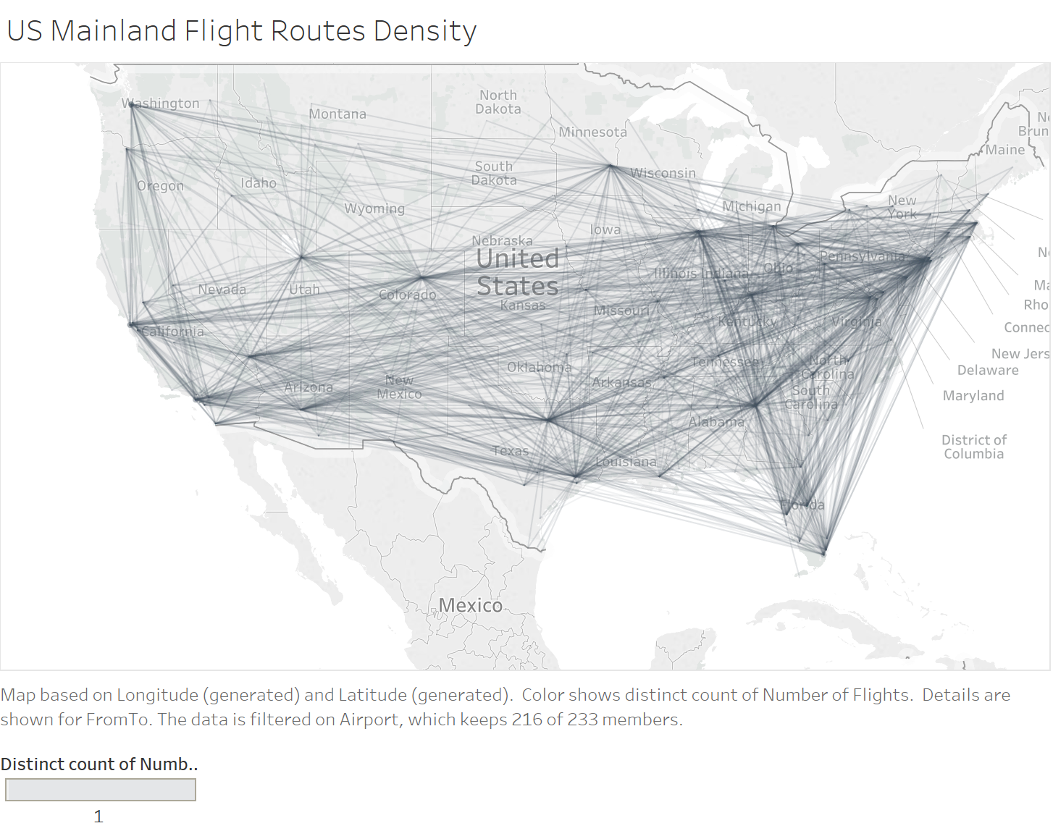
Problem statement magnitude

Slide 6
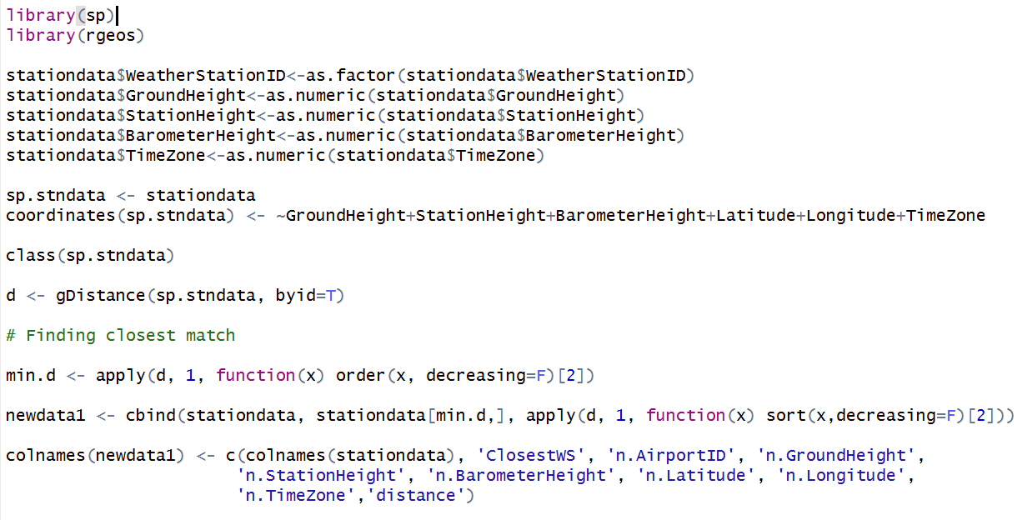
Step 1: finding proximity of weather stations

Slide 7
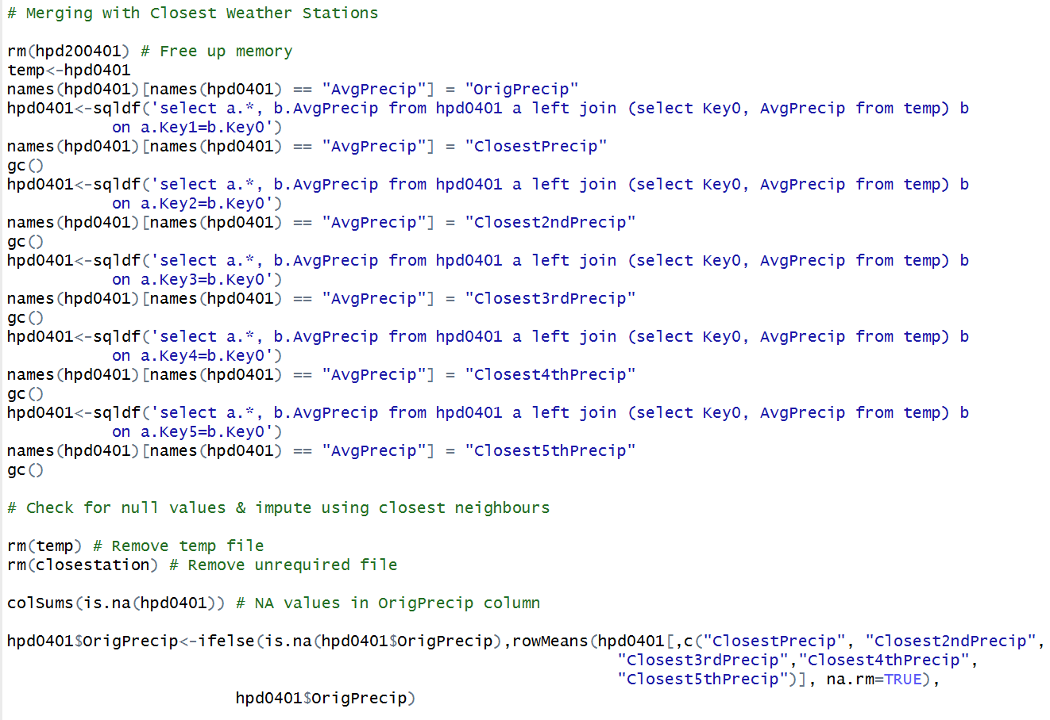
Step 2: aggregation & imputation of hourly precipitation data

Slide 8
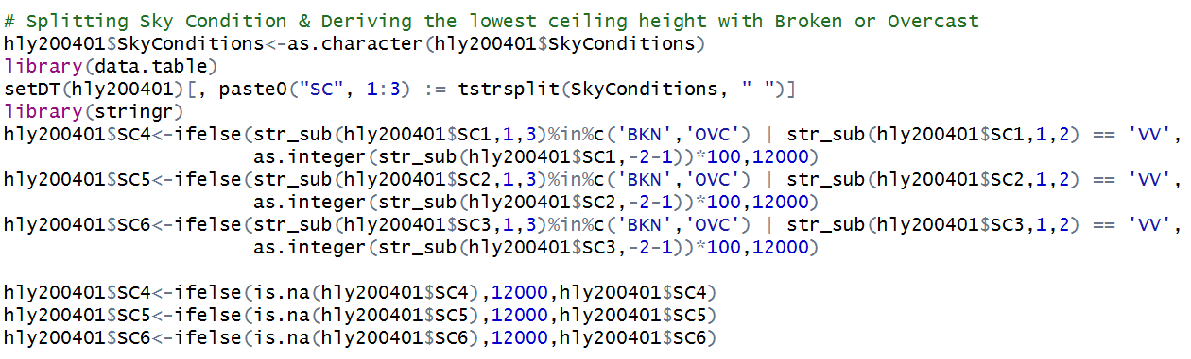
Step 3: Feature engineering, Aggregation & imputation of hourly weather data

Slide 9
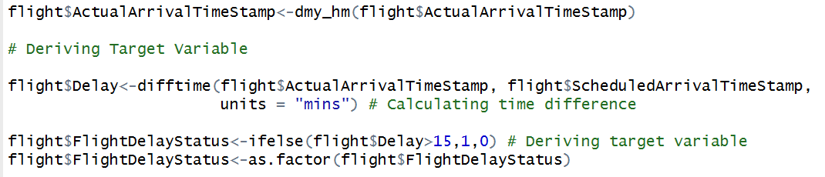
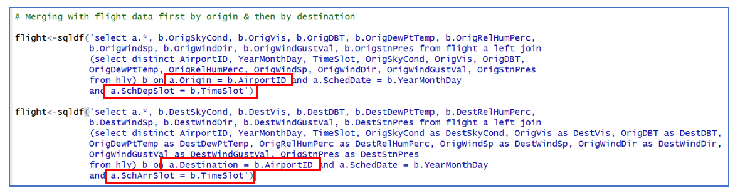
Step 4: Pre – processing train & test + merging

Slide 10
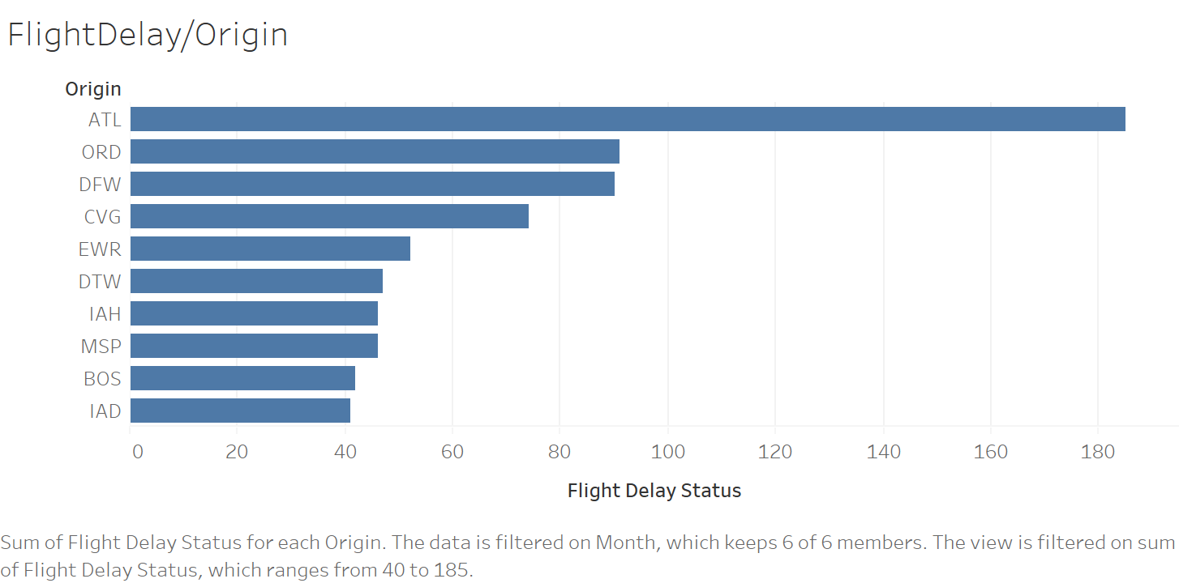
Visualization

Slide 11
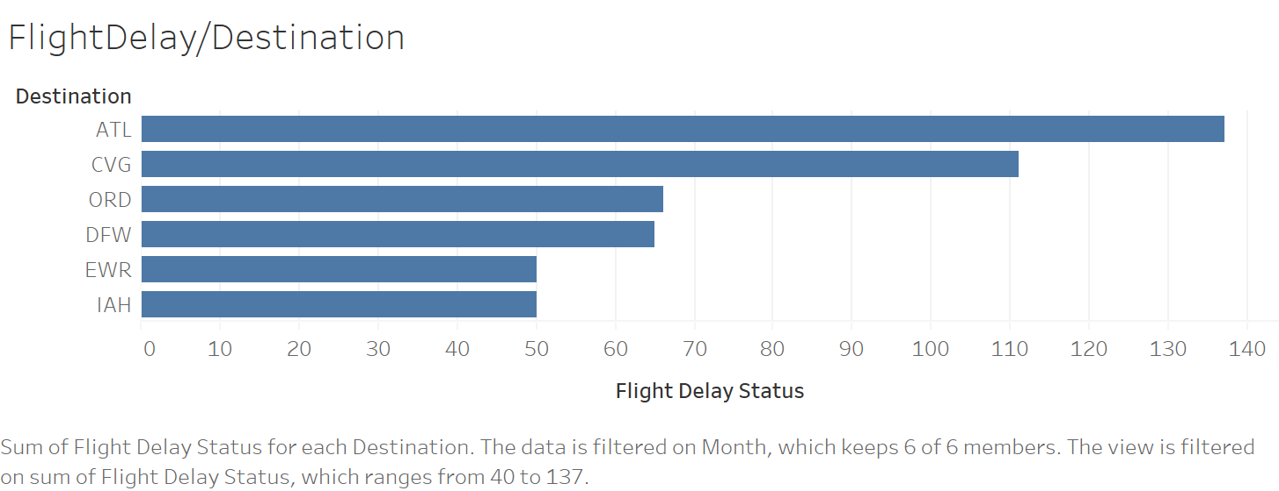
Visualization

Slide 12
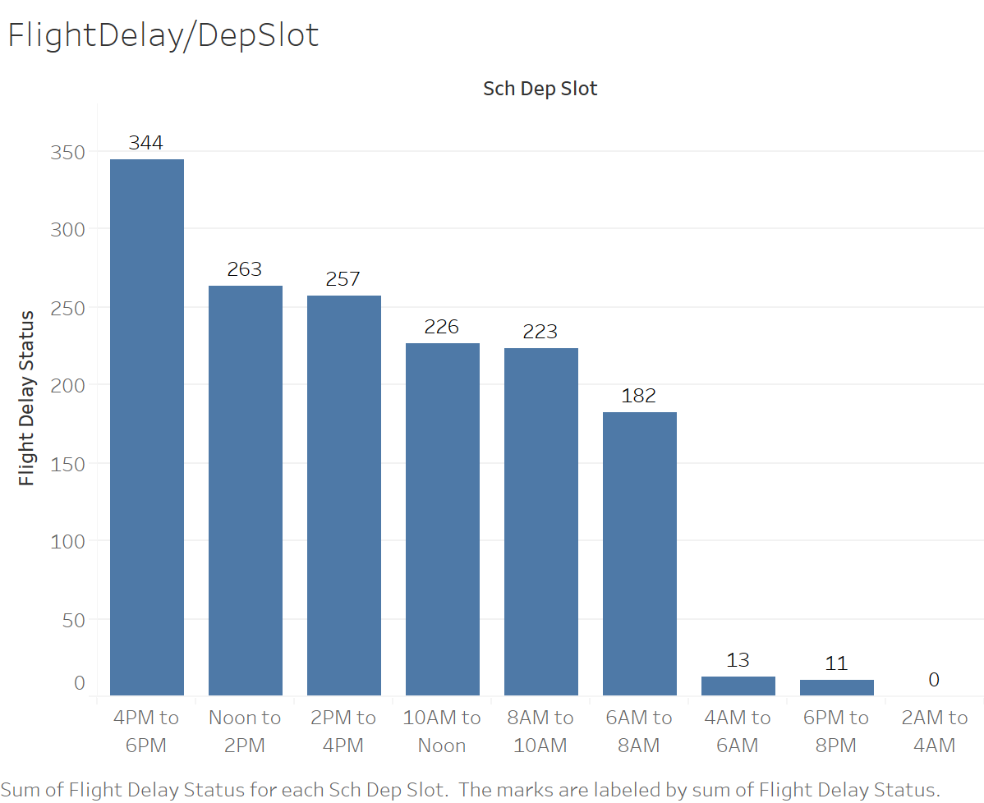
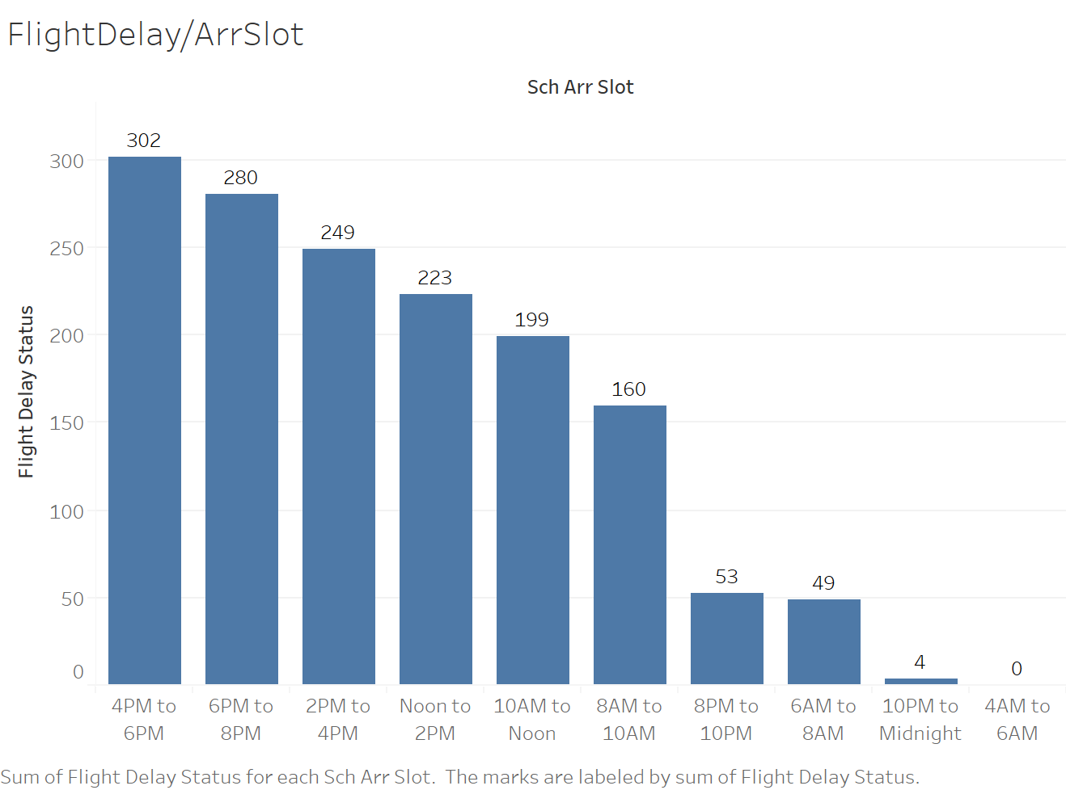
Visualization

Slide 13
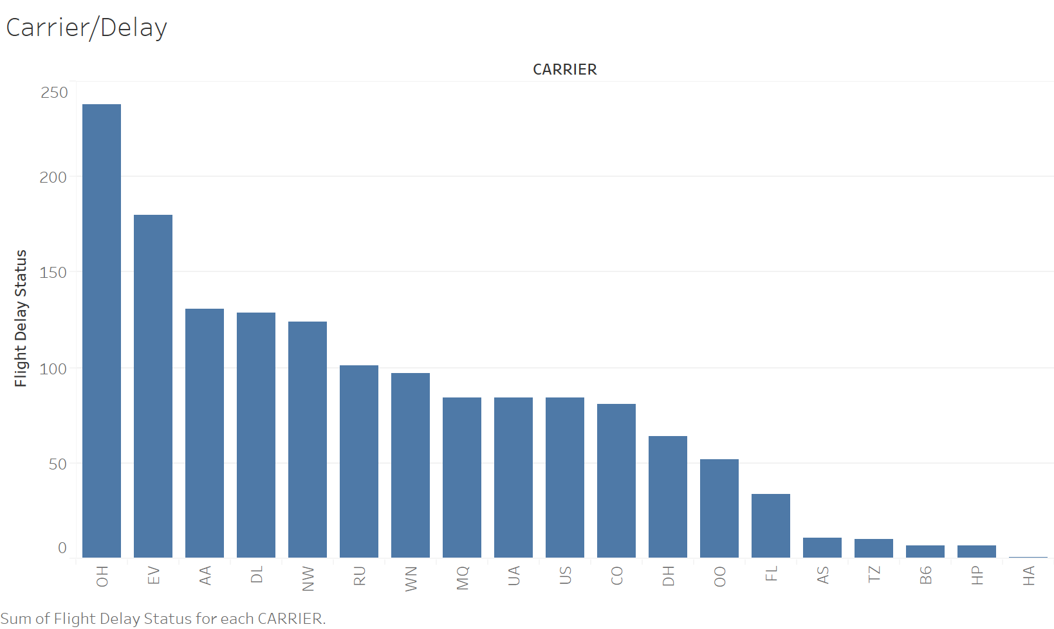
Visualization

Slide 14
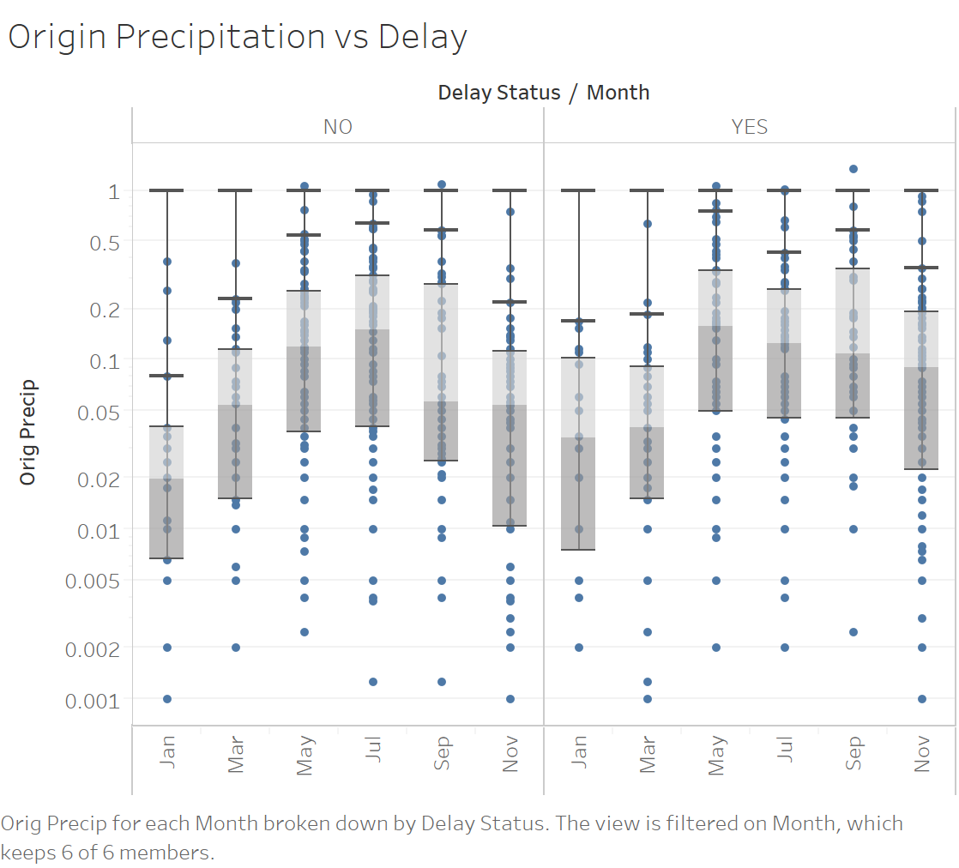
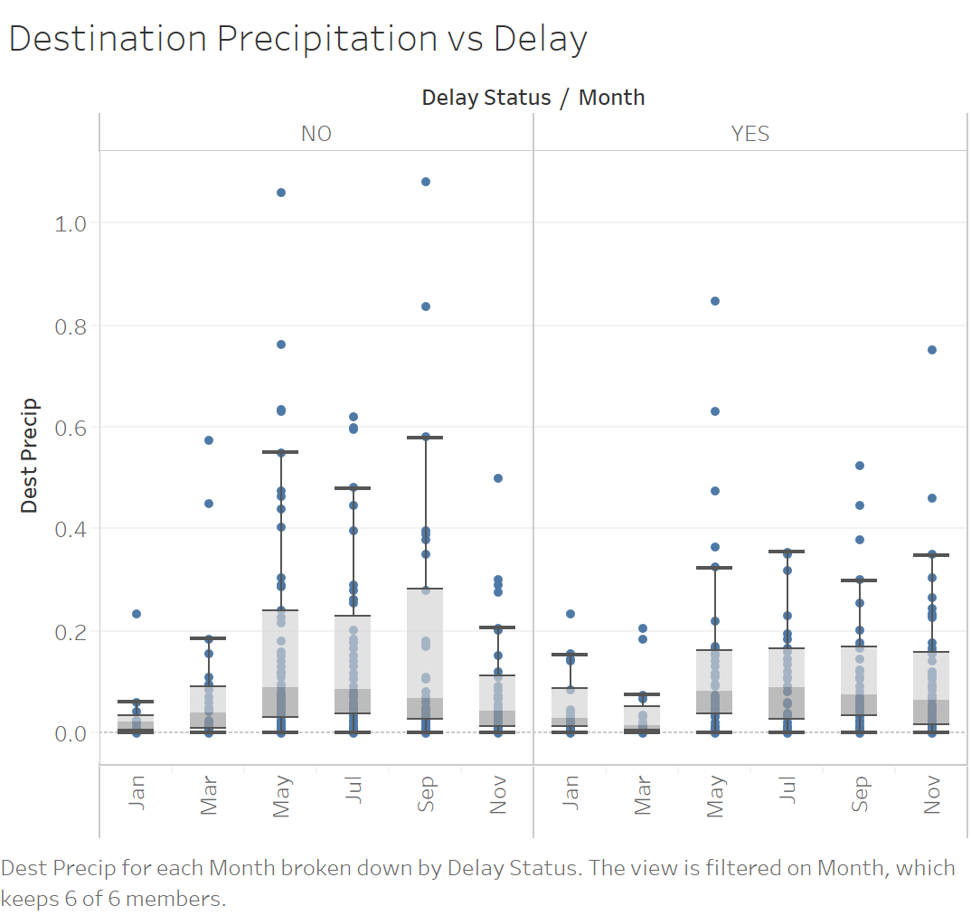
Visualization

Slide 15
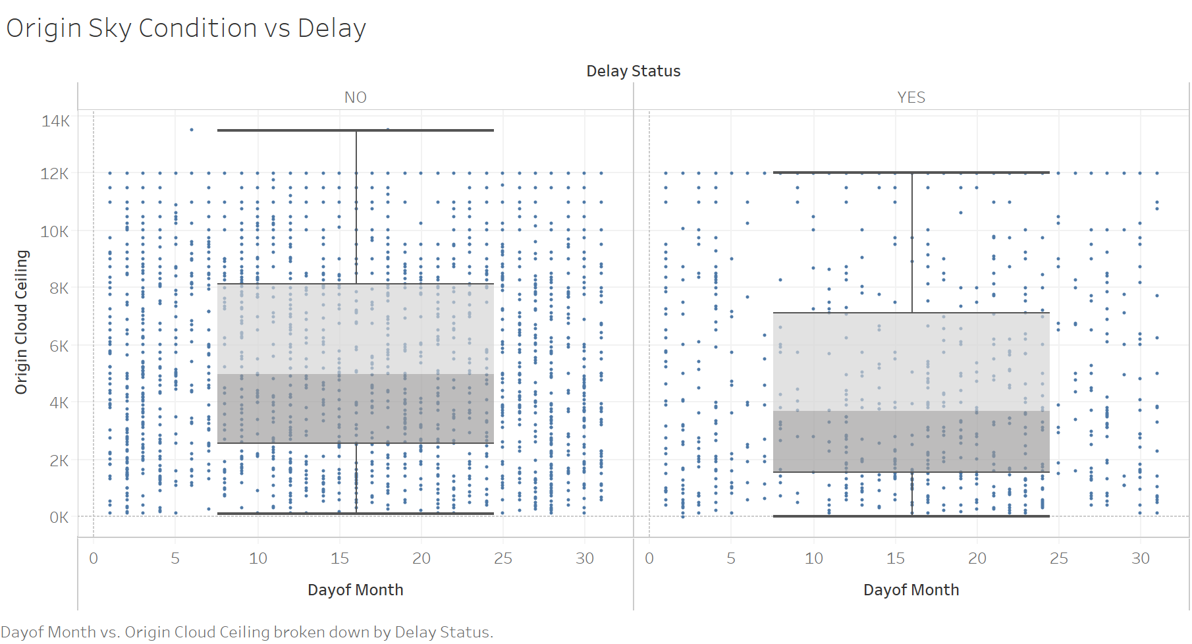
Visualization

Slide 16
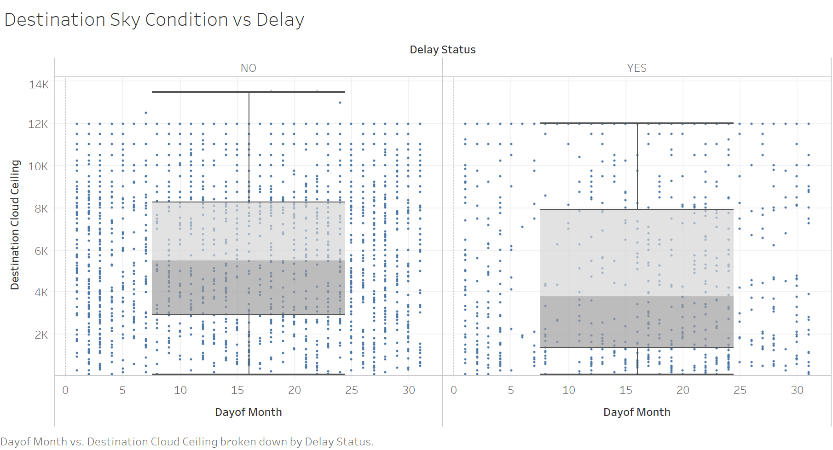
Visualization

Slide 17
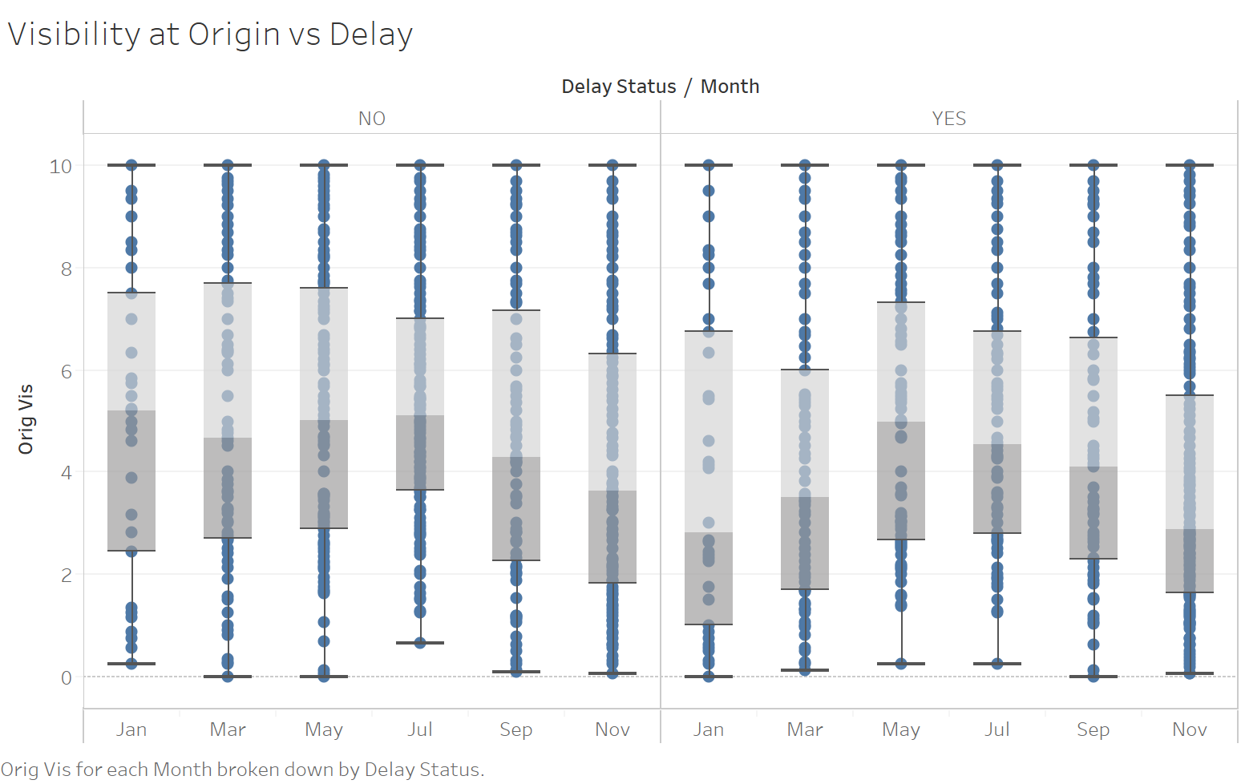
Visualization

Slide 18
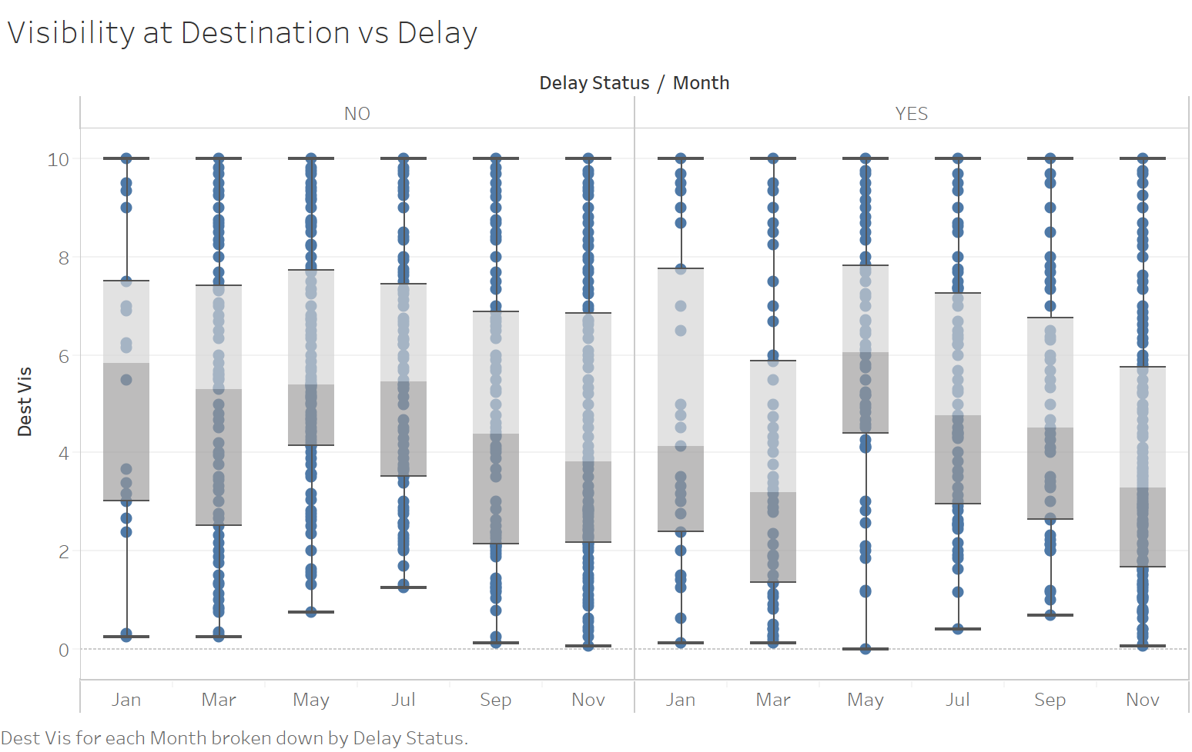
Visualization

Slide 19
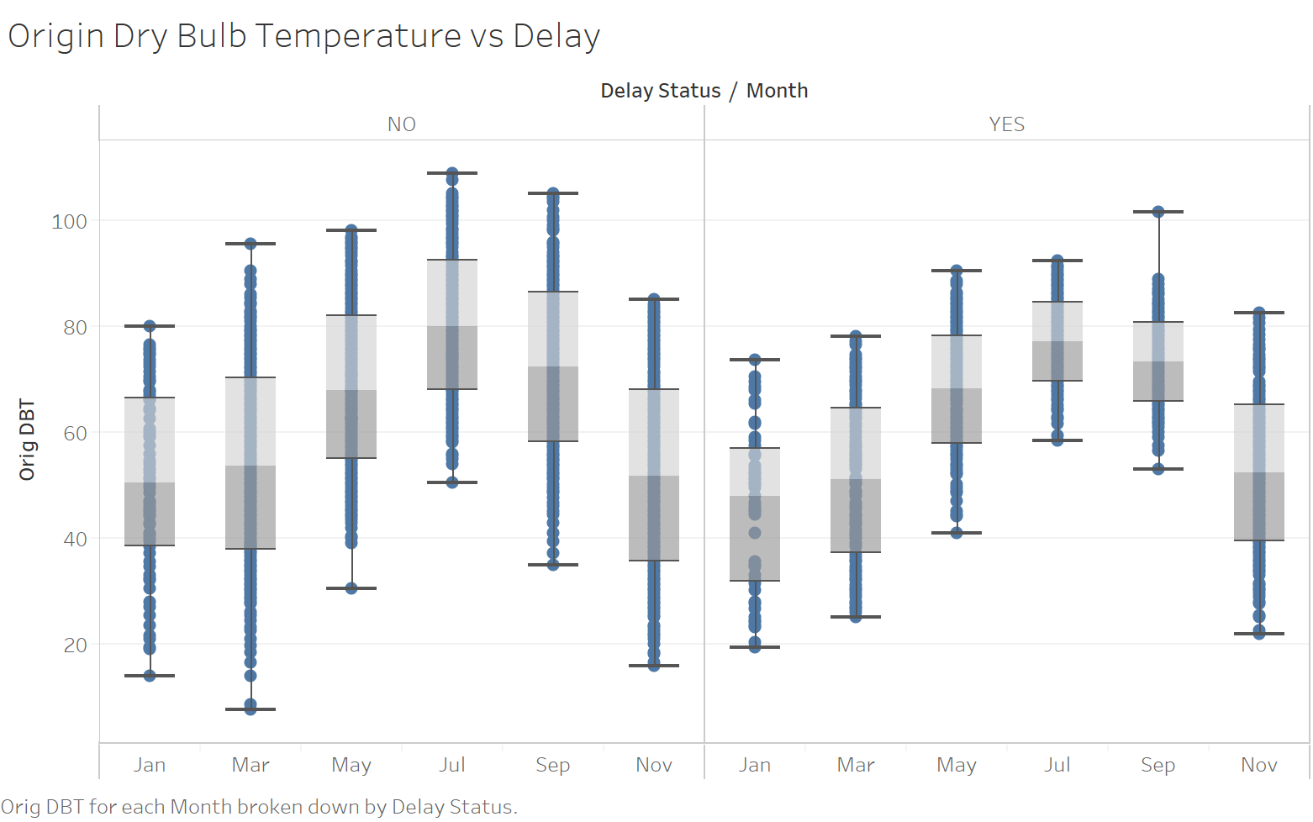
Visualization
Lower spread for ‘YES’

Slide 20
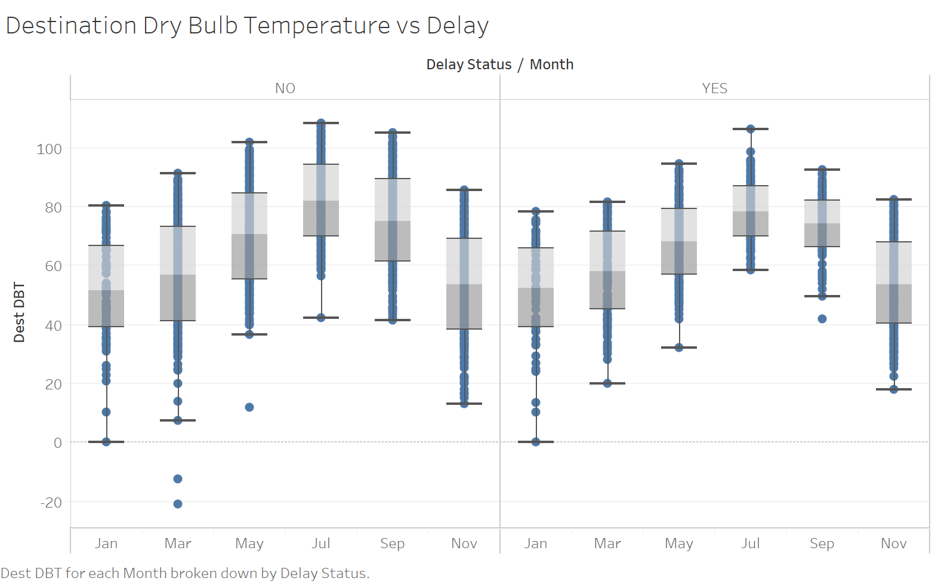
Visualization
Lower spread for ‘YES’

Slide 21
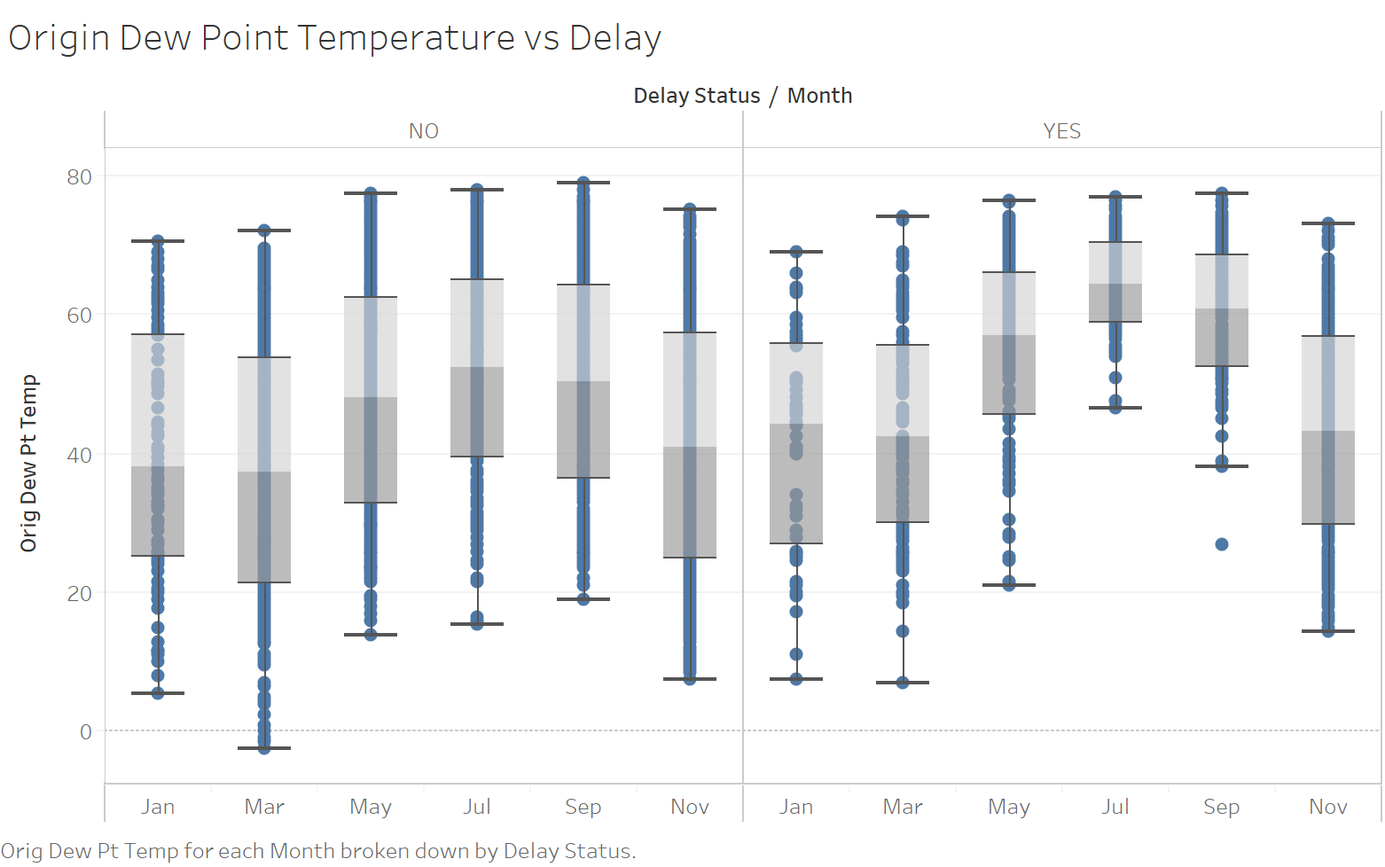
Visualization
Lower spread for ‘YES’

Slide 22
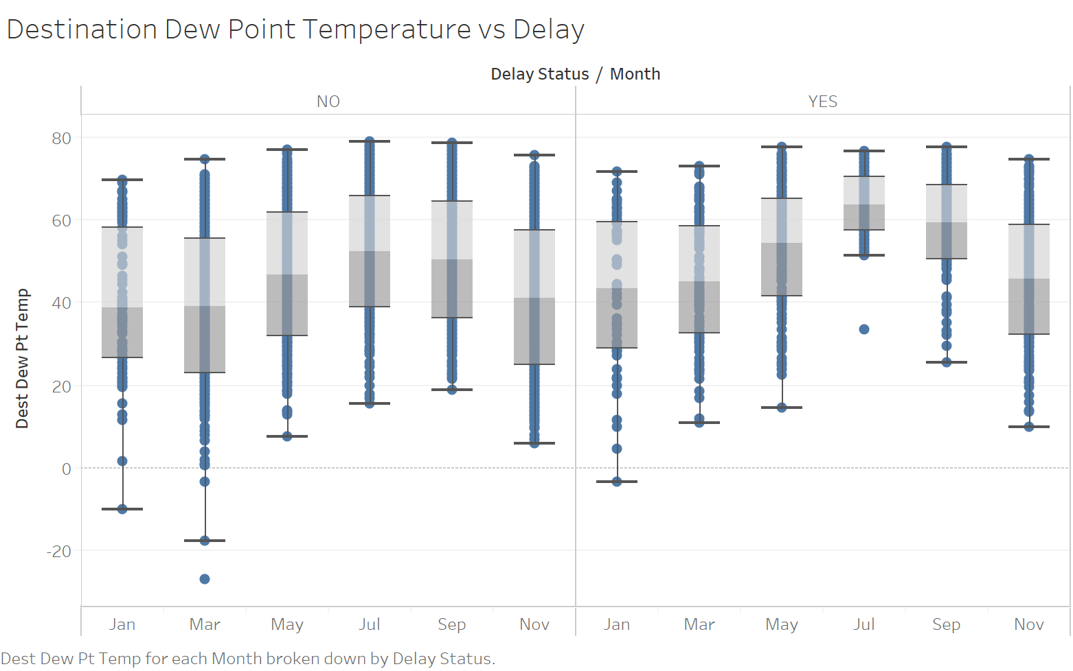
Visualization
Lower spread for ‘YES’

Slide 23
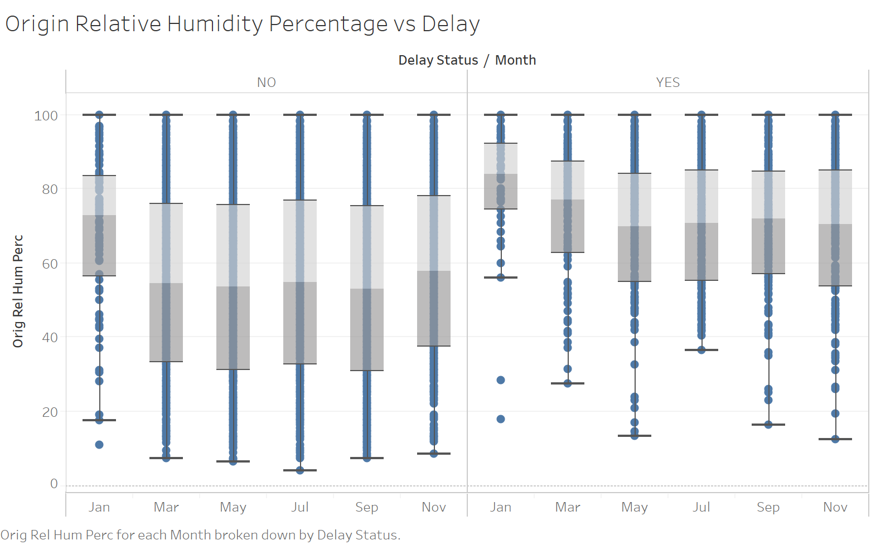
Visualization

Slide 24
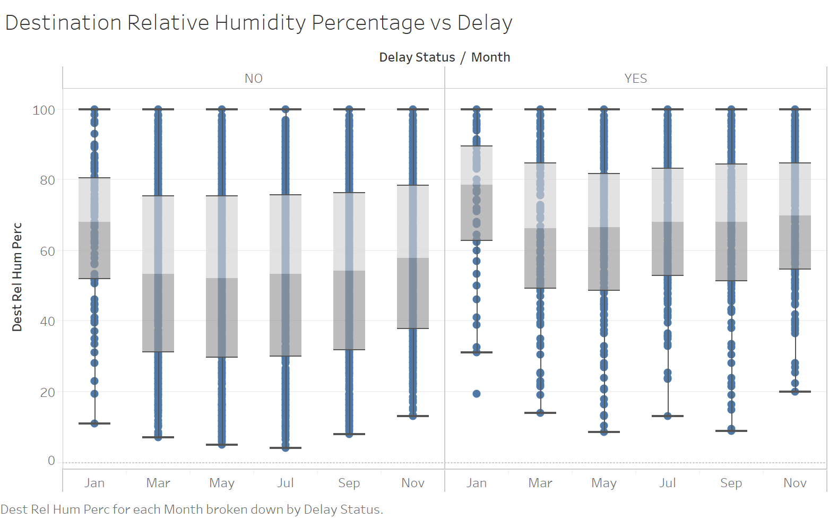
Visualization

Slide 25
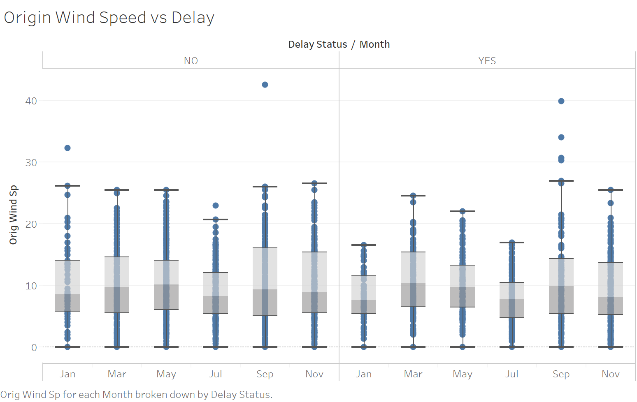
Visualization

Slide 26
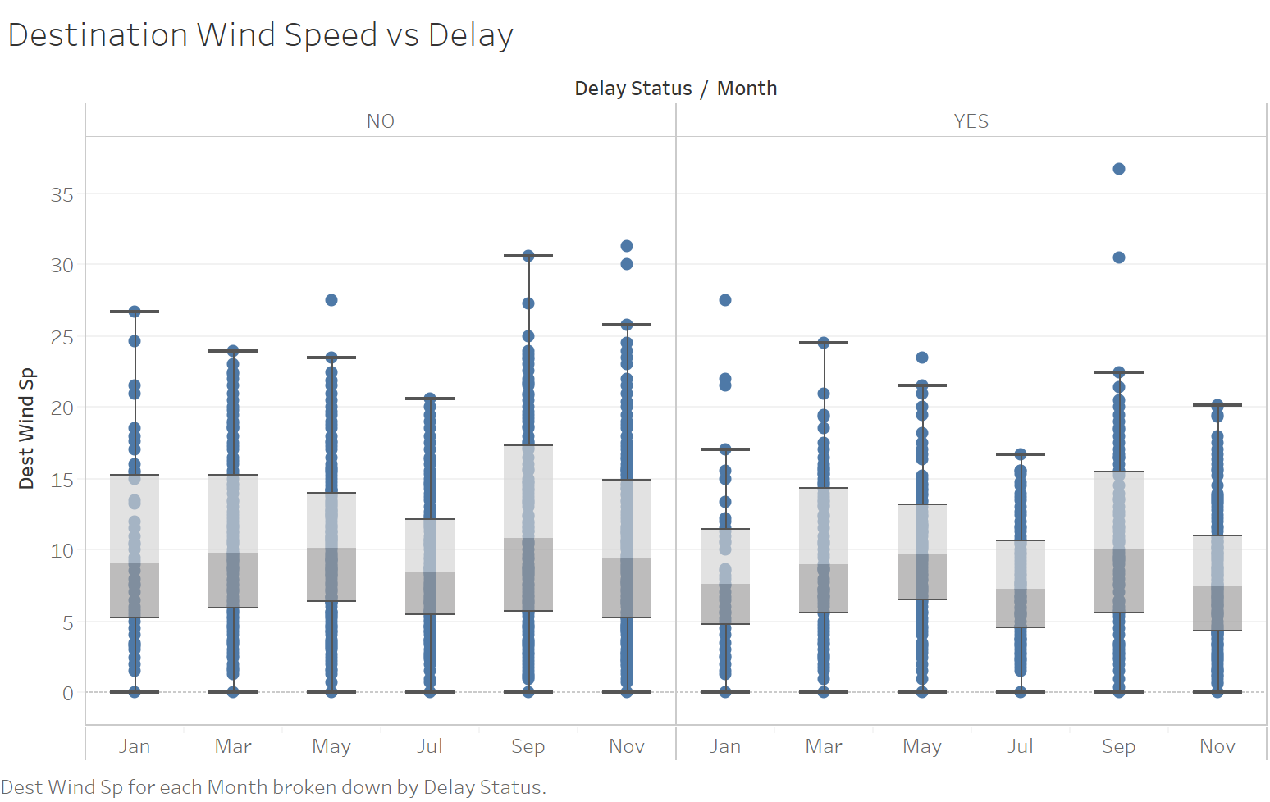
Visualization

Slide 27
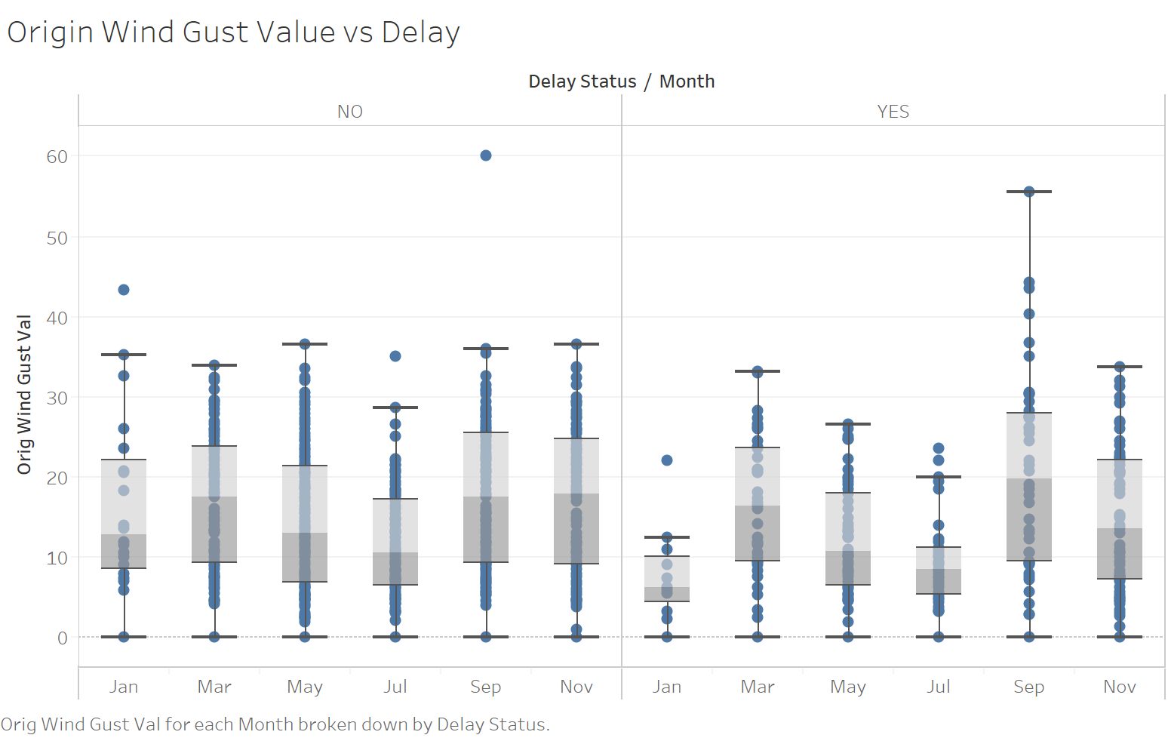
Visualization

Slide 28
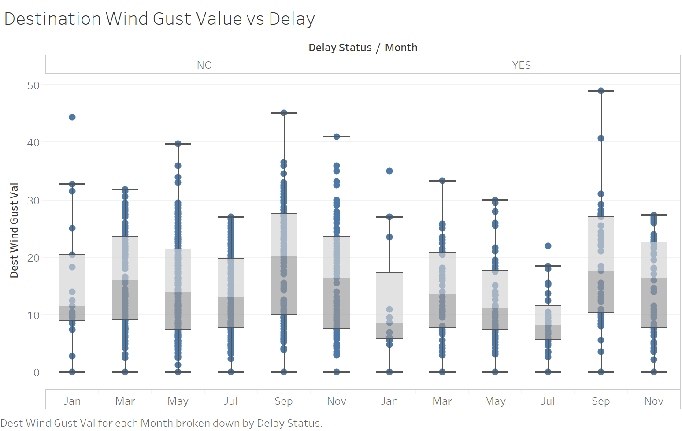
Visualization

Slide 29
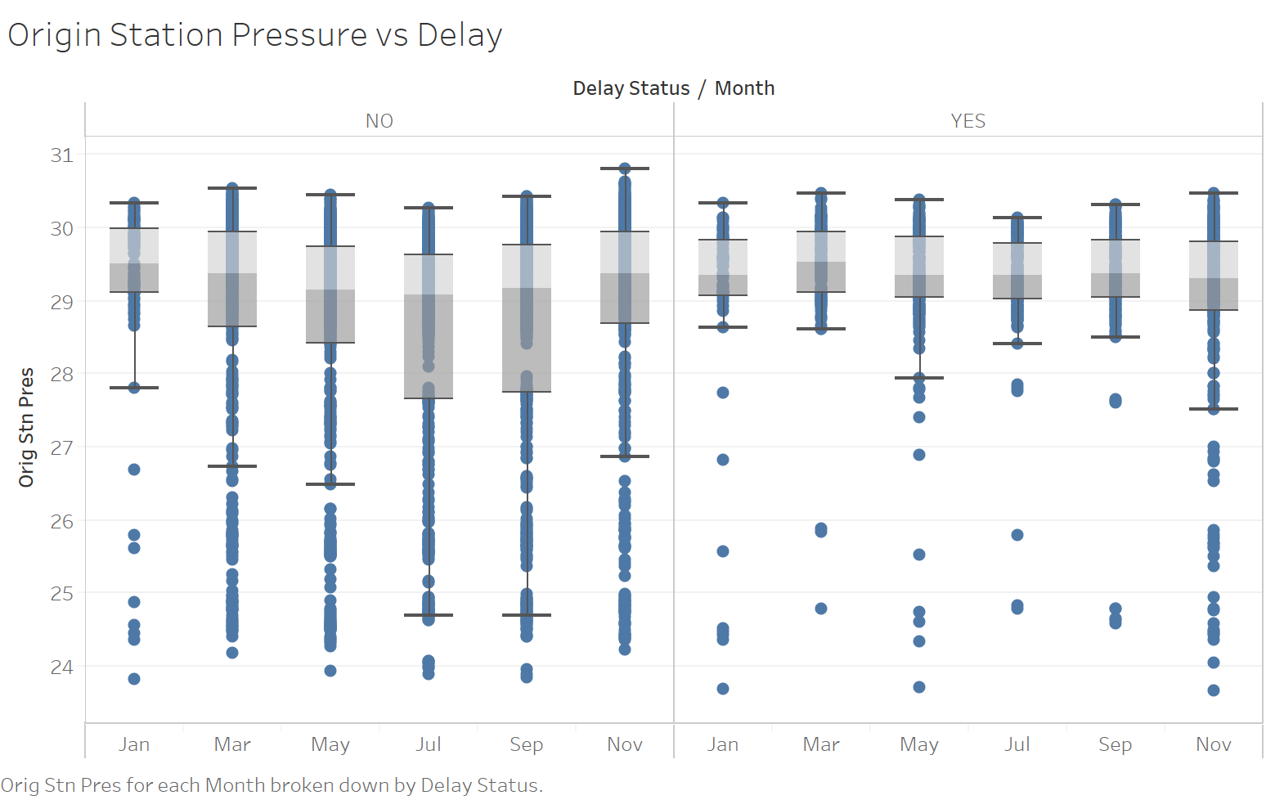
Visualization

Slide 30
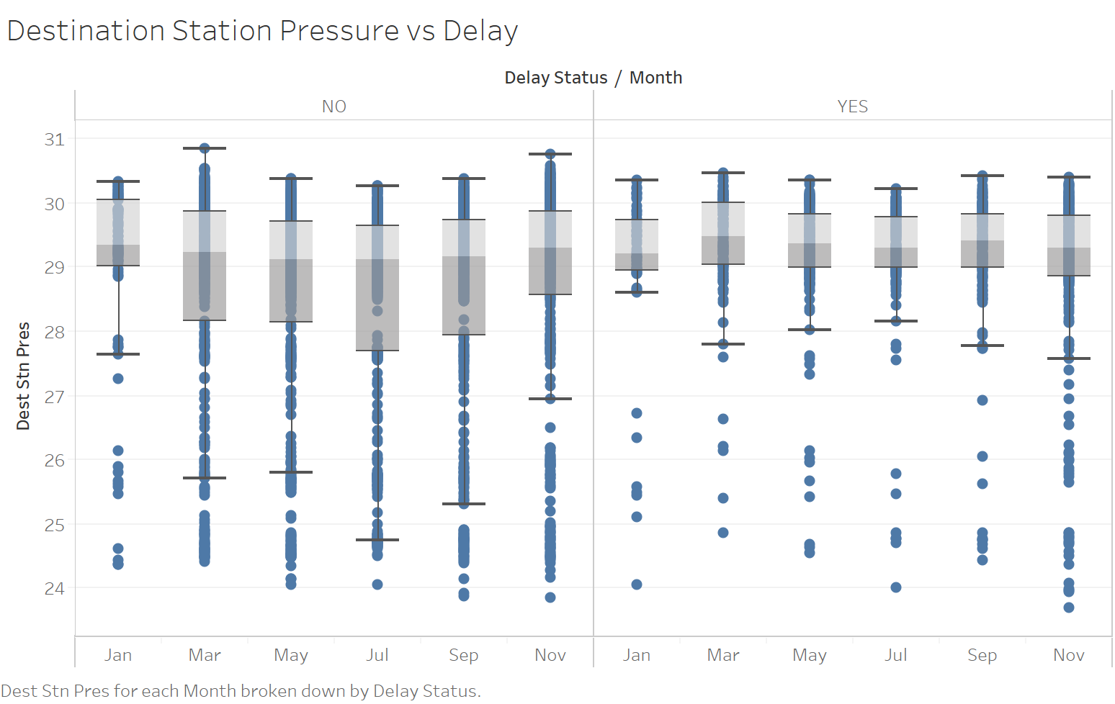
Visualization

Slide 31
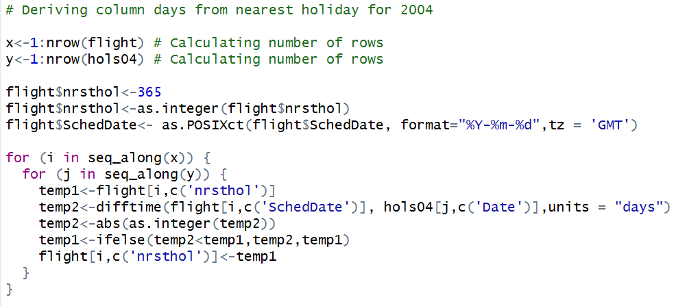
Merging with holiday calendar

Slide 32
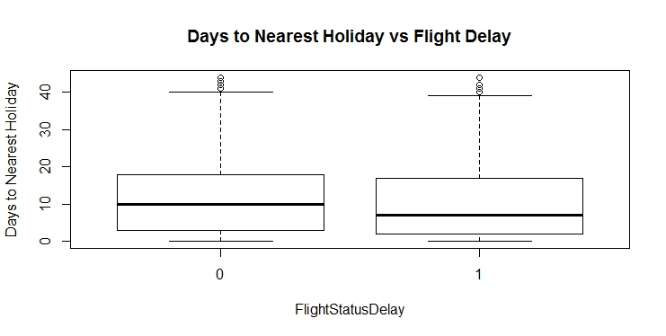
Affect of holiday calendar

Slide 33
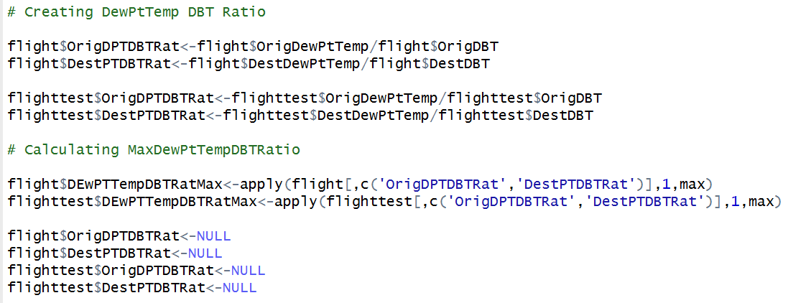
Feature engineering – dew point temp: DBT

Slide 34
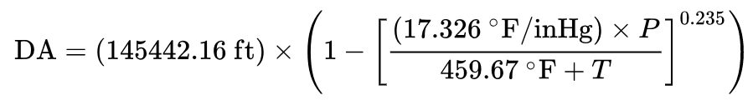
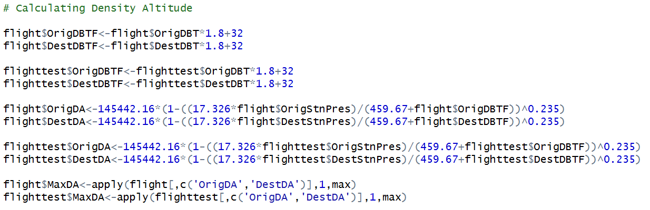
Feature engineering: density altitude

Slide 35
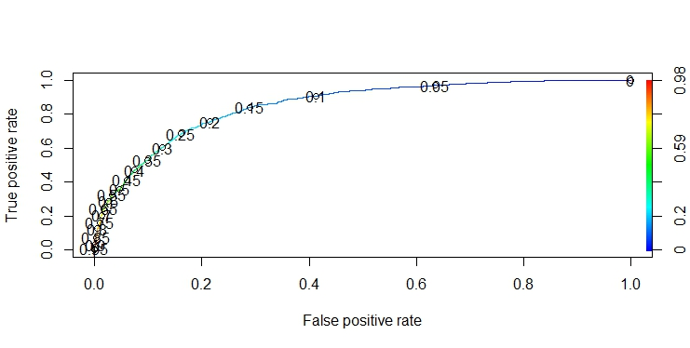
Model building - logistic
Metric | Train | Validation
Accuracy | 0.8449 | 0.8485
Sensitivity/Recall | 0.326 | 0.346
Precision | 0.6977 | 0.708
F1 Score | 0.4448 | 0.465

Slide 36
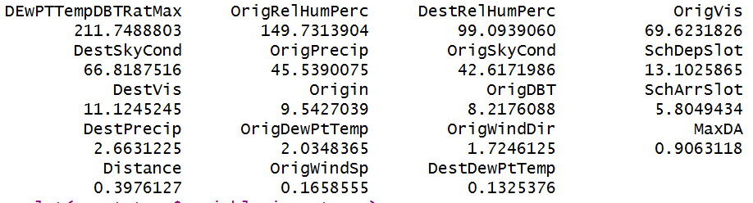
Model building – cart
Validation Performance of basic CART Model
Accuracy | 0.8356
Sensitivity | 0.3393
Specificity | 0.9522
F1 Score | 0.3533

Slide 37
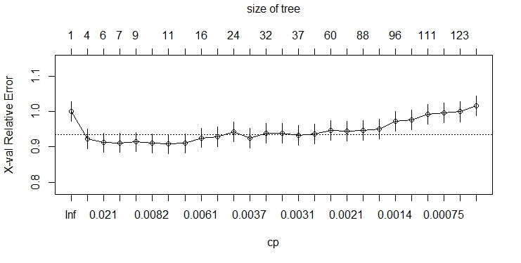
Tuned model cart
Validation Performance of tuned CART Model
Accuracy | 0.8378
Sensitivity | 0.3710
Specificity | 0.9474
F1 Score | 0.3768

Slide 38
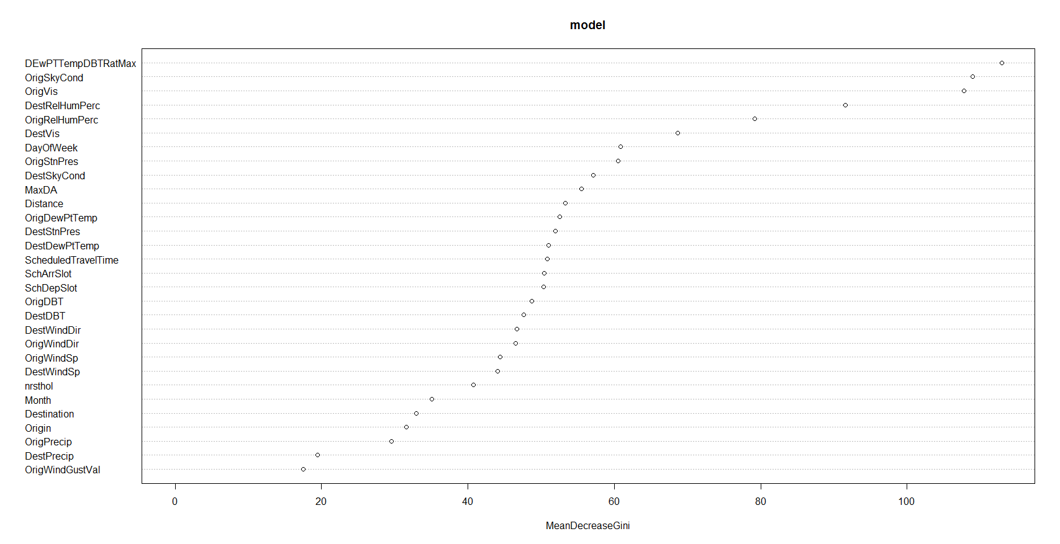
Model building – random forest
Validation Performance of basic RF Model
Accuracy | 0.858
Sensitivity | 0.4118
Specificity | 0.9628
F1 Score | 0.4483

Slide 39
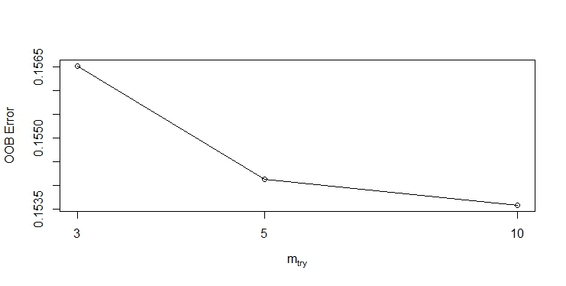
Tuned model – random forest
Validation Performance of tuned RF Model
Accuracy | 0.8597
Sensitivity | 0.4186
Specificity | 0.9633
F1 Score | 0.4561

Slide 40
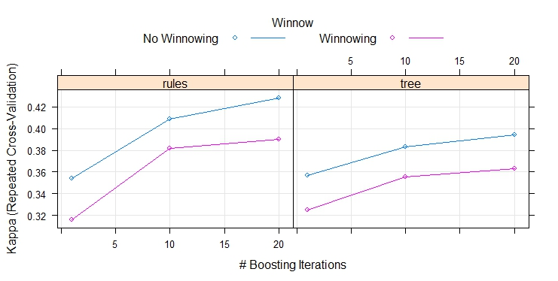
Model building – c5 with cross validation
Accuracy | 0.8386
Sensitivity | 0.4977
Specificity | 0.9187
F1 Score | 0.4429

Slide 41
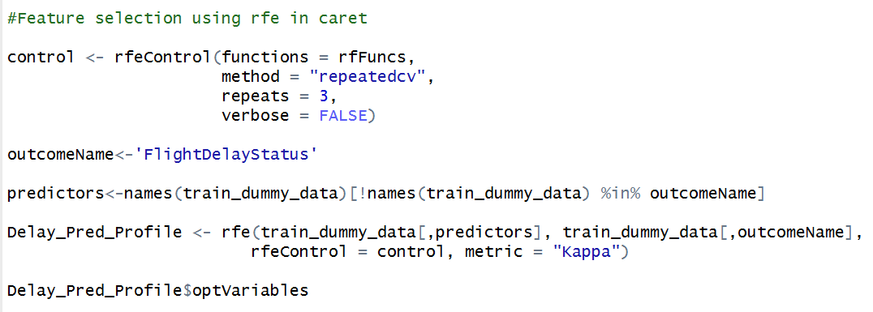
Feature selection – caret (‘rfe’)

Slide 42
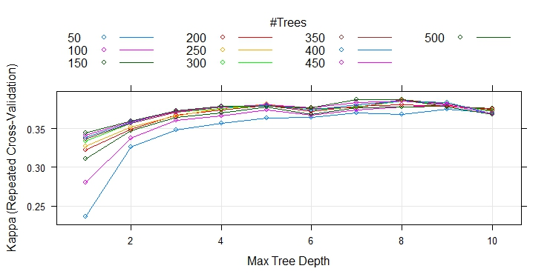
Model building – ada boost with large subset feature selection
Accuracy | 0.8438
Sensitivity | 0.3914
Specificity | 0.9501
F1 Score | 0.4024

Slide 43
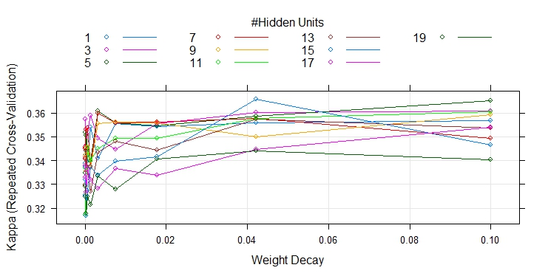
Model building – neural net with large subset feature selection
Accuracy | 0.8231
Sensitivity | 0.3937
Specificity | 0.9240
F1 Score | 0.3562

Slide 44
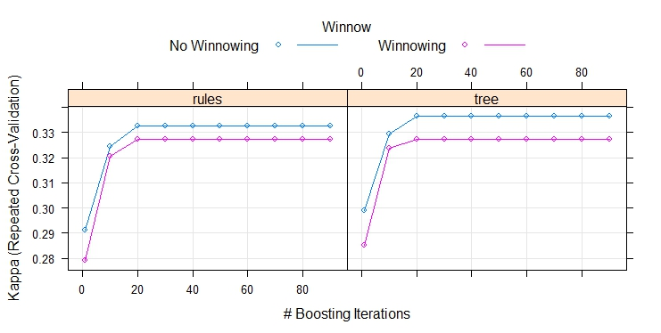
Model building – C5.0 with small subset feature selection
Accuracy | 0.8382
Sensitivity | 0.3213
Specificity | 0.9596
F1 Score | 0.3484

Slide 45
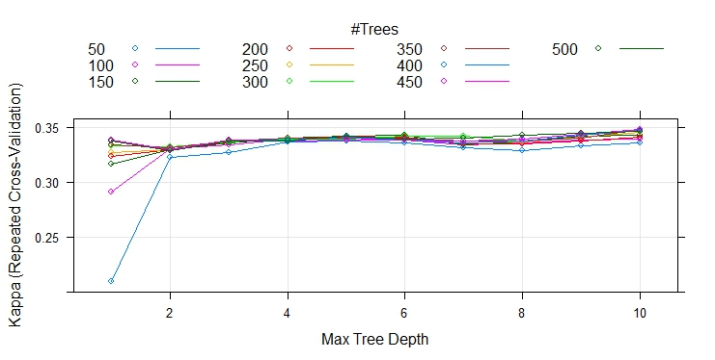
Model building – ada boost with small subset feature selection
Accuracy | 0.8391
Sensitivity/Recall | 0.3801
Specificity | 0.9469
Kappa | 0.3849

Slide 46
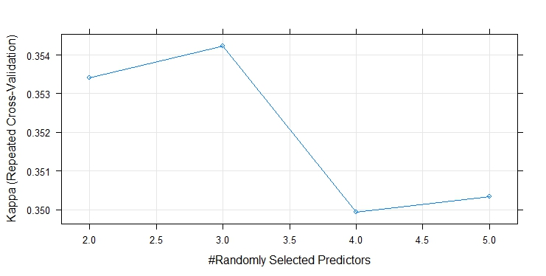
Model building – random forest with small subset feature selection
Accuracy | 0.8305
Sensitivity | 0.3823
Specificity | 0.9357
Kappa | 0.3662

